Slide 1
Dynamic Analysis – Establish Settings
AVCDL-Implementation-8.1.1
Charles Wilson
Staff Product Cybersecurity Architect
version 2
2025-10-06
Notes:
Script:
I'm Charles Wilson, staff product cybersecurity architect at Torc Robotics.
This presentation will cover the Dynamic Analysis Settings Establishment activity.

Slide 2
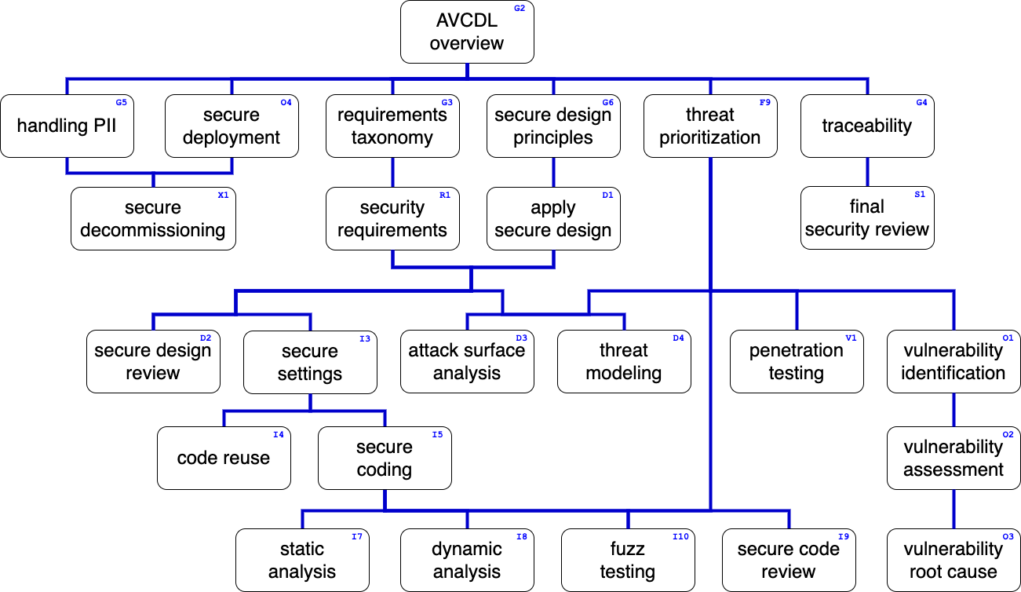
Training Path
Notes:
Script:
This diagram shows the overall AVCDL training path.
If you're taking this training, it's assumed that you've already completed the AVCDL Overview training,
and additionally, that you've completed the
Requirements Taxonomy
Security Requirements
Secure Design Principles
Apply Secure Design
Threat Prioritization
Secure Settings
Secure Coding
and
Dynamic Analysis Overview
trainings.
This training will cover Dynamic Analysis Settings Establishment.

Slide 3
Introduction
Notes:
Script:
Before getting into settings establishment, let's briefly review where it fits, in the overall dynamic analysis process.

Slide 4
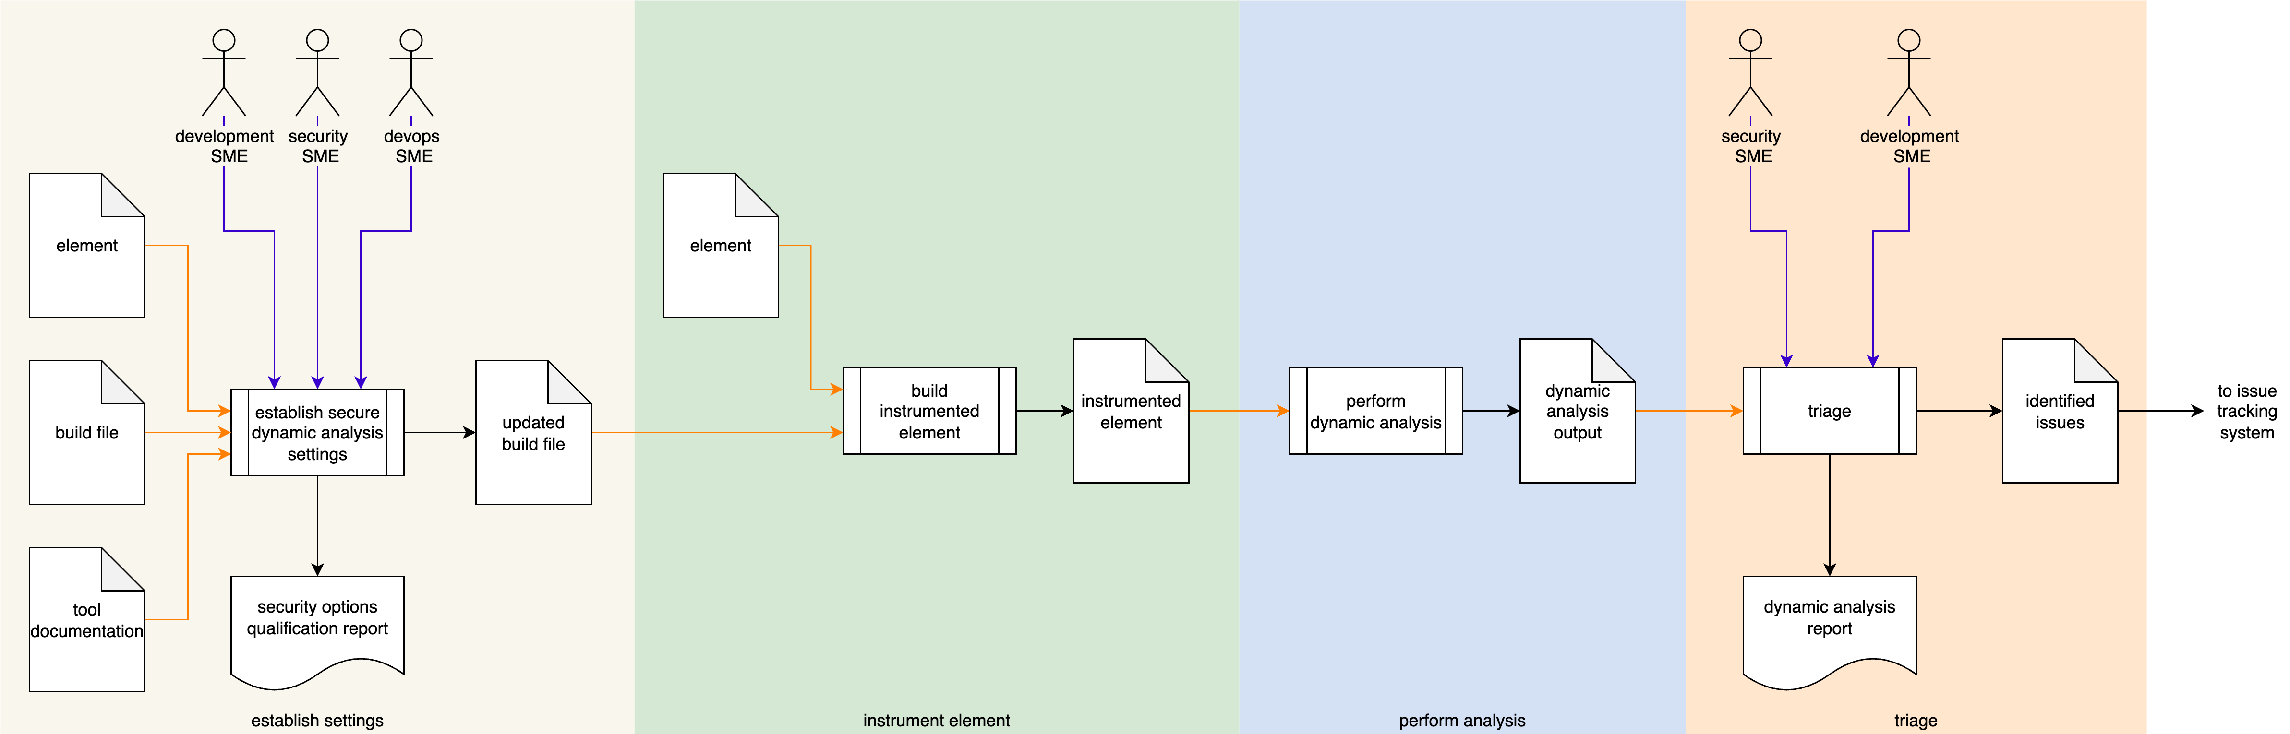
Dynamic Analysis Process
Notes:
Script:
Here's the dynamic analysis process which we previously covered in the Dynamic Analysis Overview.
[break]
Our focus for this training is going to be on the first activity, that of settings establishment.

Slide 5
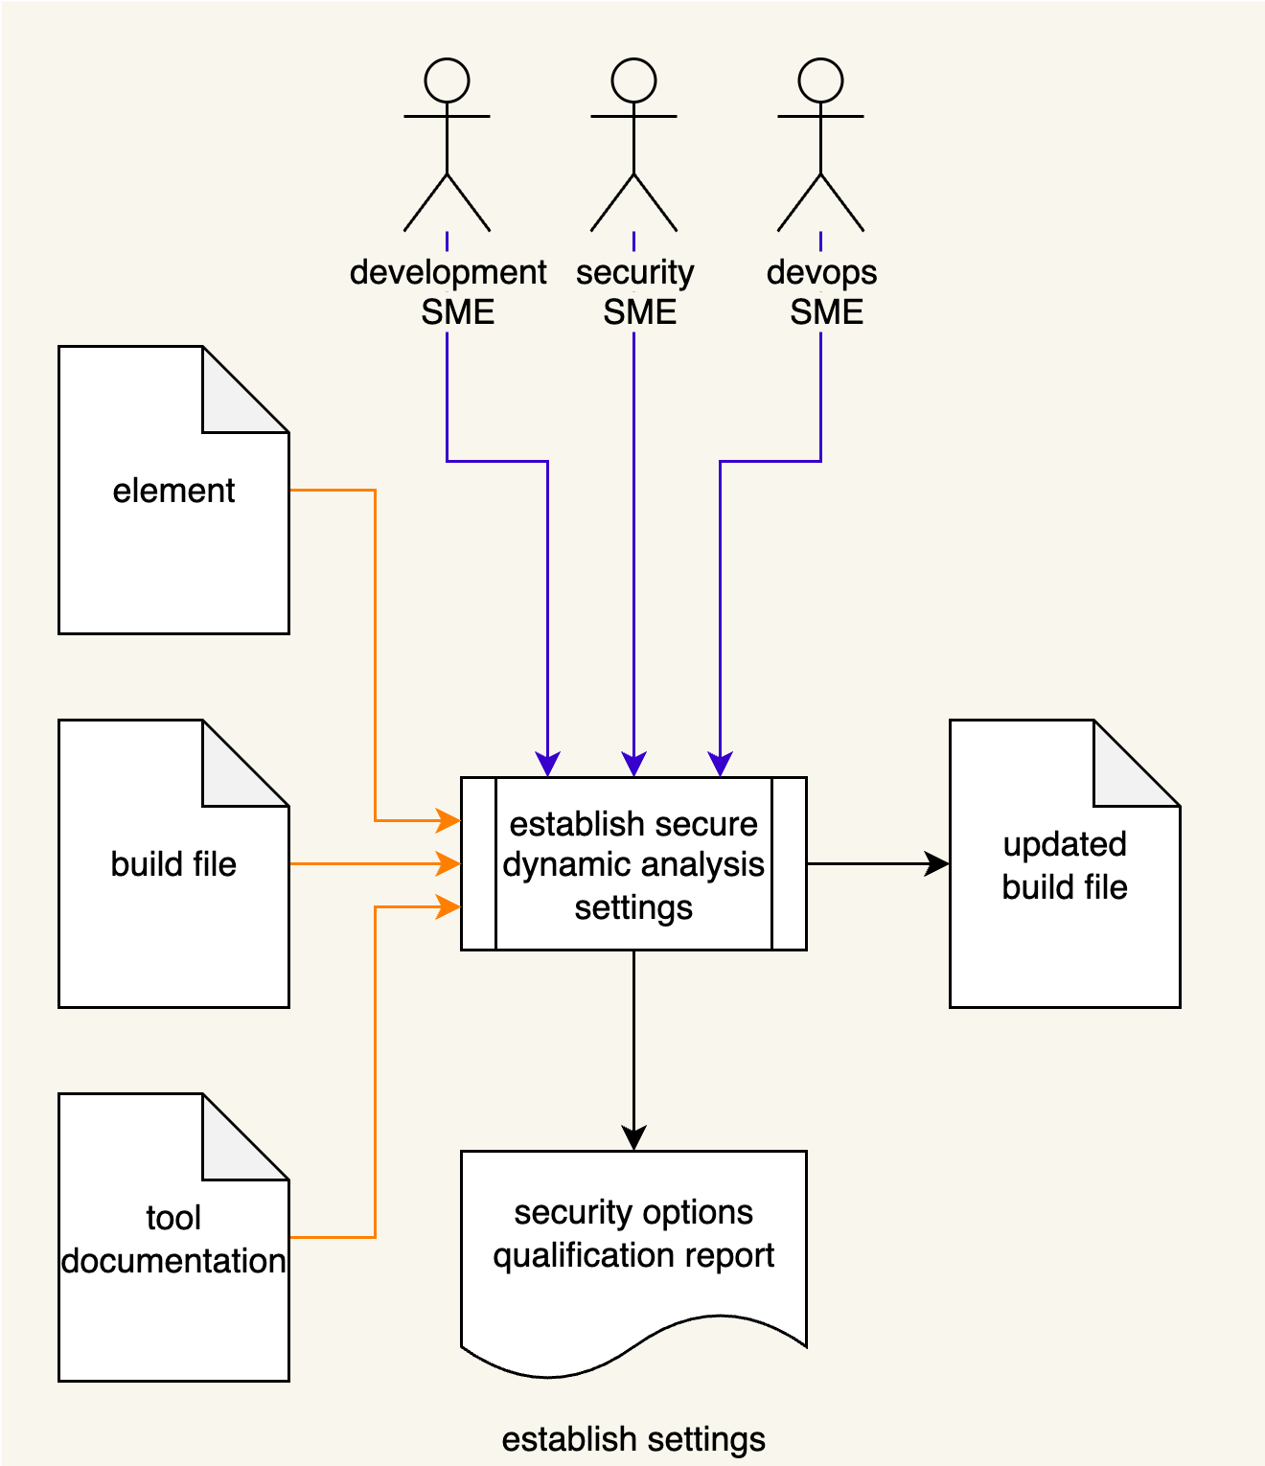
Dynamic Analysis Process
Notes:
Script:
Here's the dynamic analysis process which we previously covered in the Dynamic Analysis Overview.
[break]
Our focus for this training is going to be on the first activity, that of settings establishment.

Slide 6
Establish Settings Activity
Notes:
Script:
Within the settings establishment activity,
The development, security, and devops SMEs take
[pause]
the tool documentation,
[pause]
element documentation
[pause]
and build file,
[pause]
and establish a set a of element-specific settings,
[pause]
creating an updated build file
[pause]
and generating a security options qualification report.
[pause]
Now if this diagram seems really information-dense, that's because this is the encapsulation of the secure settings process.
Let’s revisit that process.

Slide 7
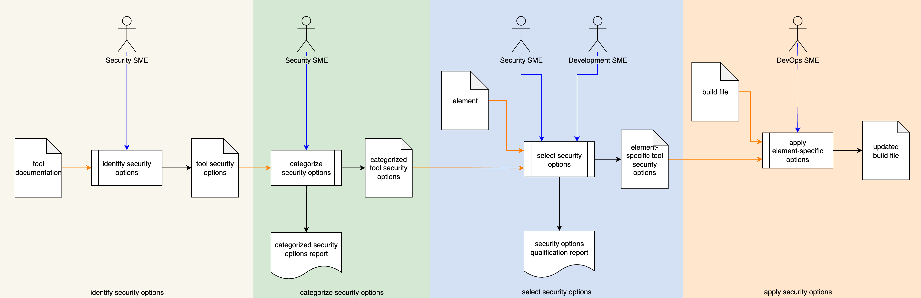
Secure Settings Process
Notes:
Script:
The secure settings process is comprised of four activities.
These are:
[break]
identifying the options relevant to security
[break]
categorizing those options
[break]
selecting which ones we're going to use for each element
[break]
and finally, applying those options to the build system for that element.

Slide 8
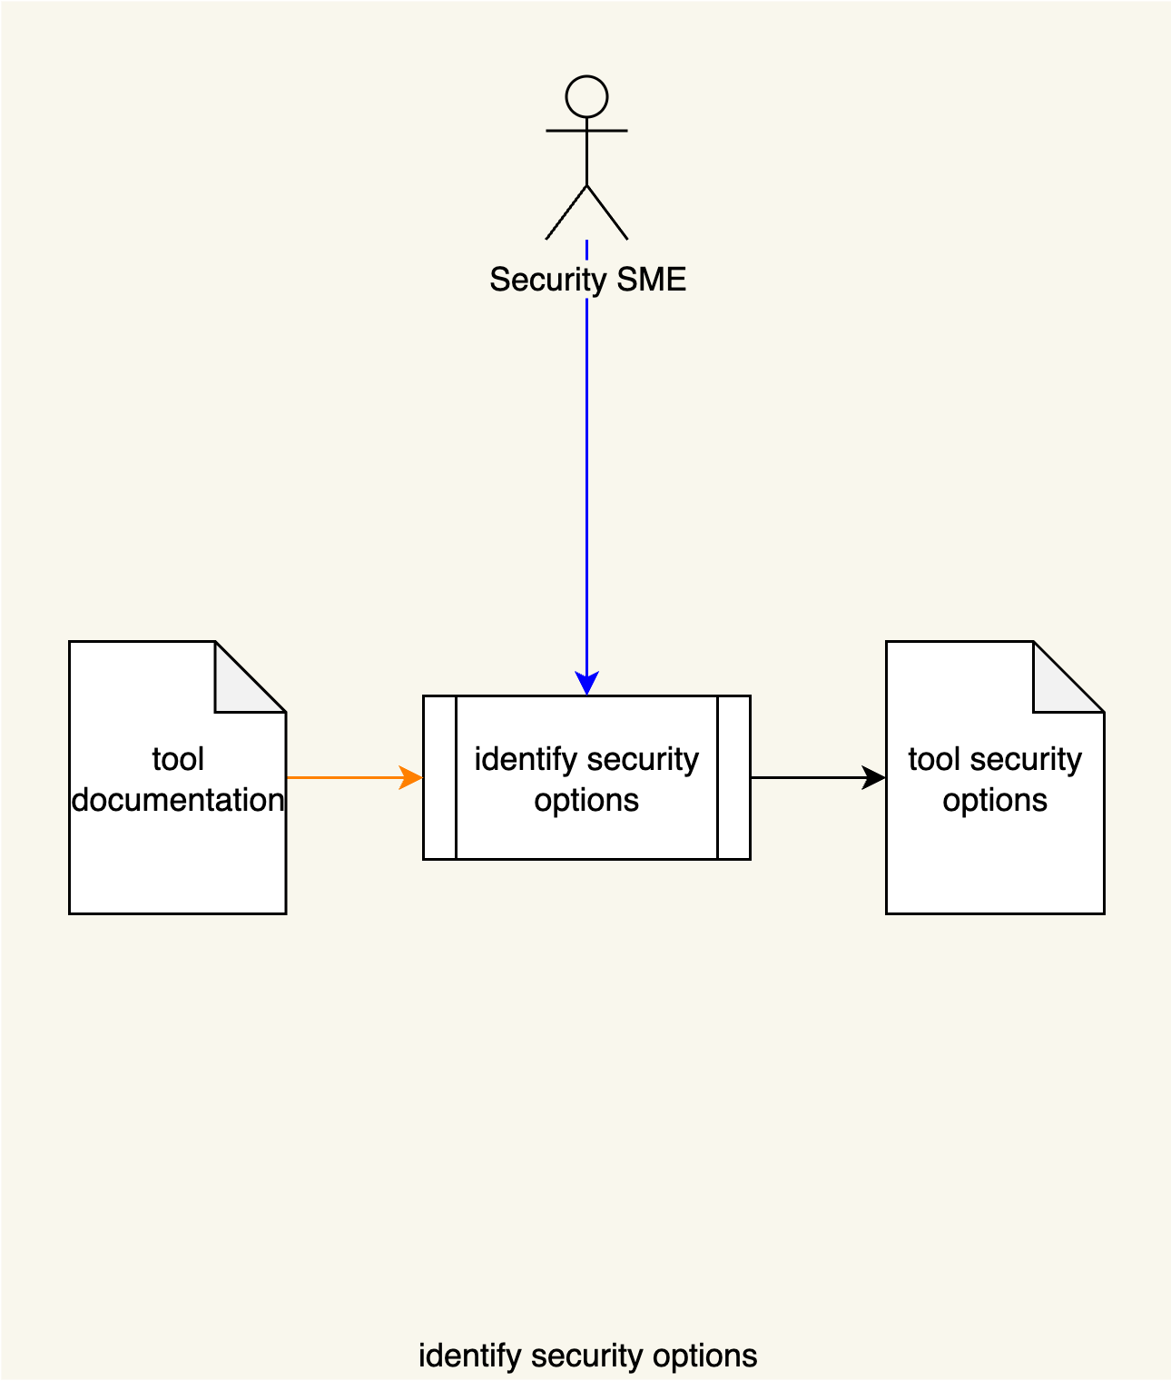
Secure Settings Process
Notes:
Script:
The secure settings process is comprised of four activities.
These are:
[break]
identifying the options relevant to security
[break]
categorizing those options
[break]
selecting which ones we're going to use for each element
[break]
and finally, applying those options to the build system for that element.

Slide 9
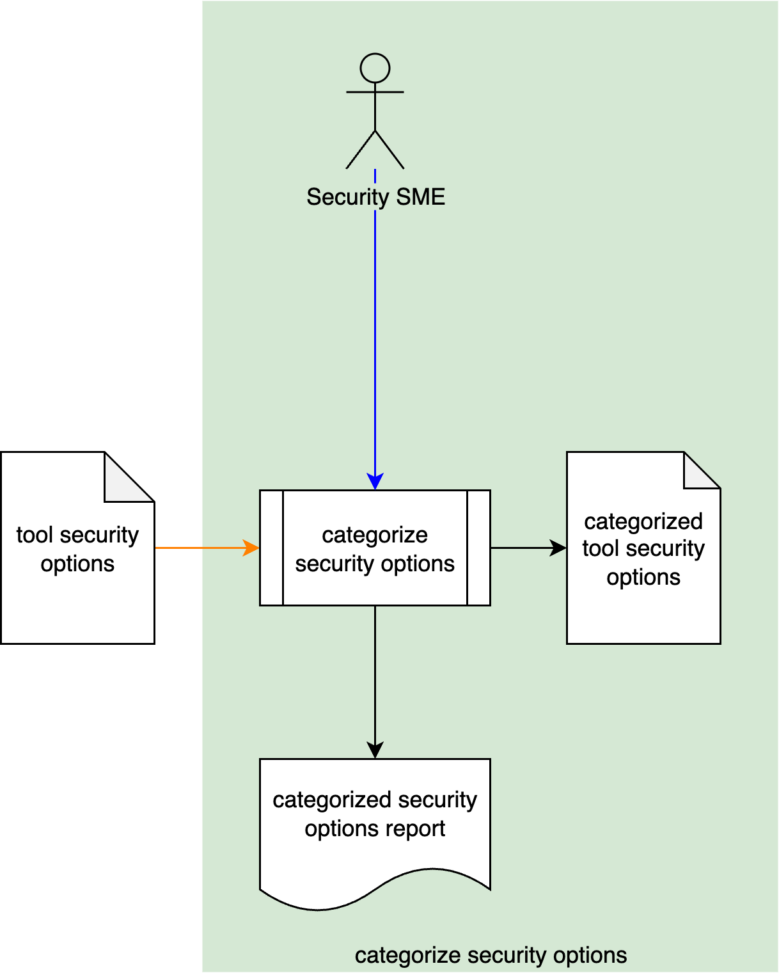
Secure Settings Process
Notes:
Script:
The secure settings process is comprised of four activities.
These are:
[break]
identifying the options relevant to security
[break]
categorizing those options
[break]
selecting which ones we're going to use for each element
[break]
and finally, applying those options to the build system for that element.

Slide 10
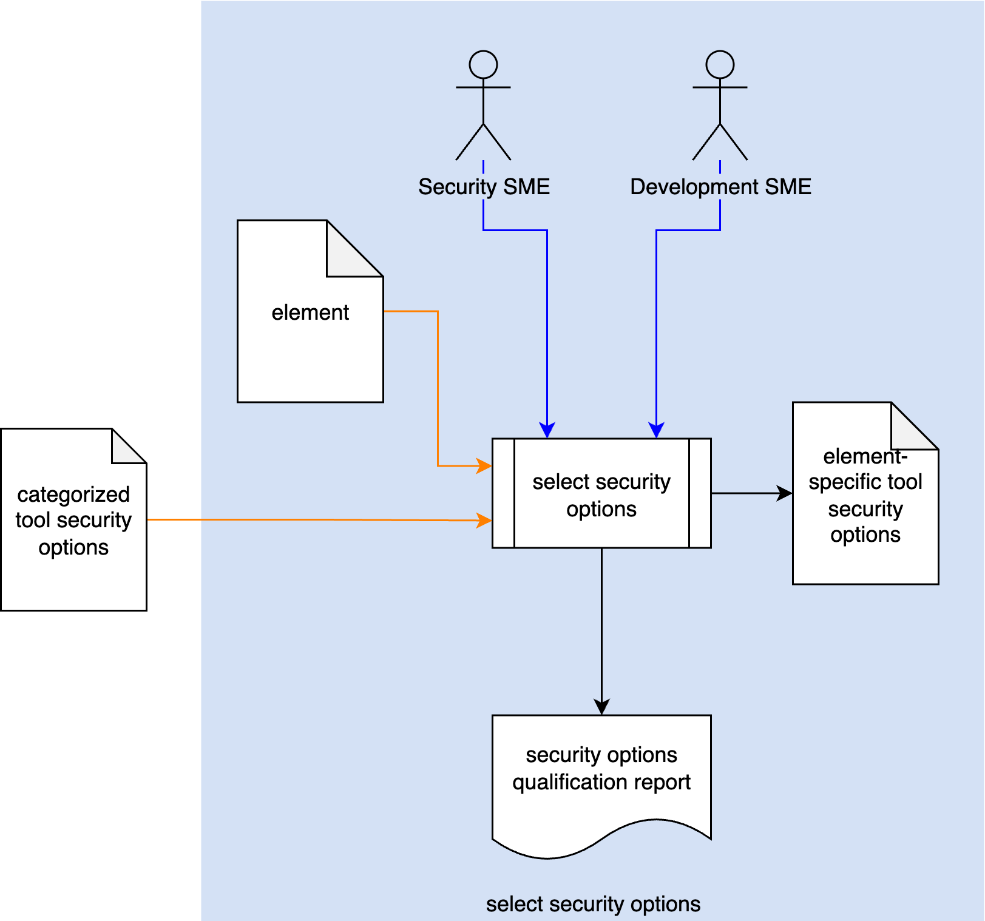
Secure Settings Process
Notes:
Script:
The secure settings process is comprised of four activities.
These are:
[break]
identifying the options relevant to security
[break]
categorizing those options
[break]
selecting which ones we're going to use for each element
[break]
and finally, applying those options to the build system for that element.

Slide 11
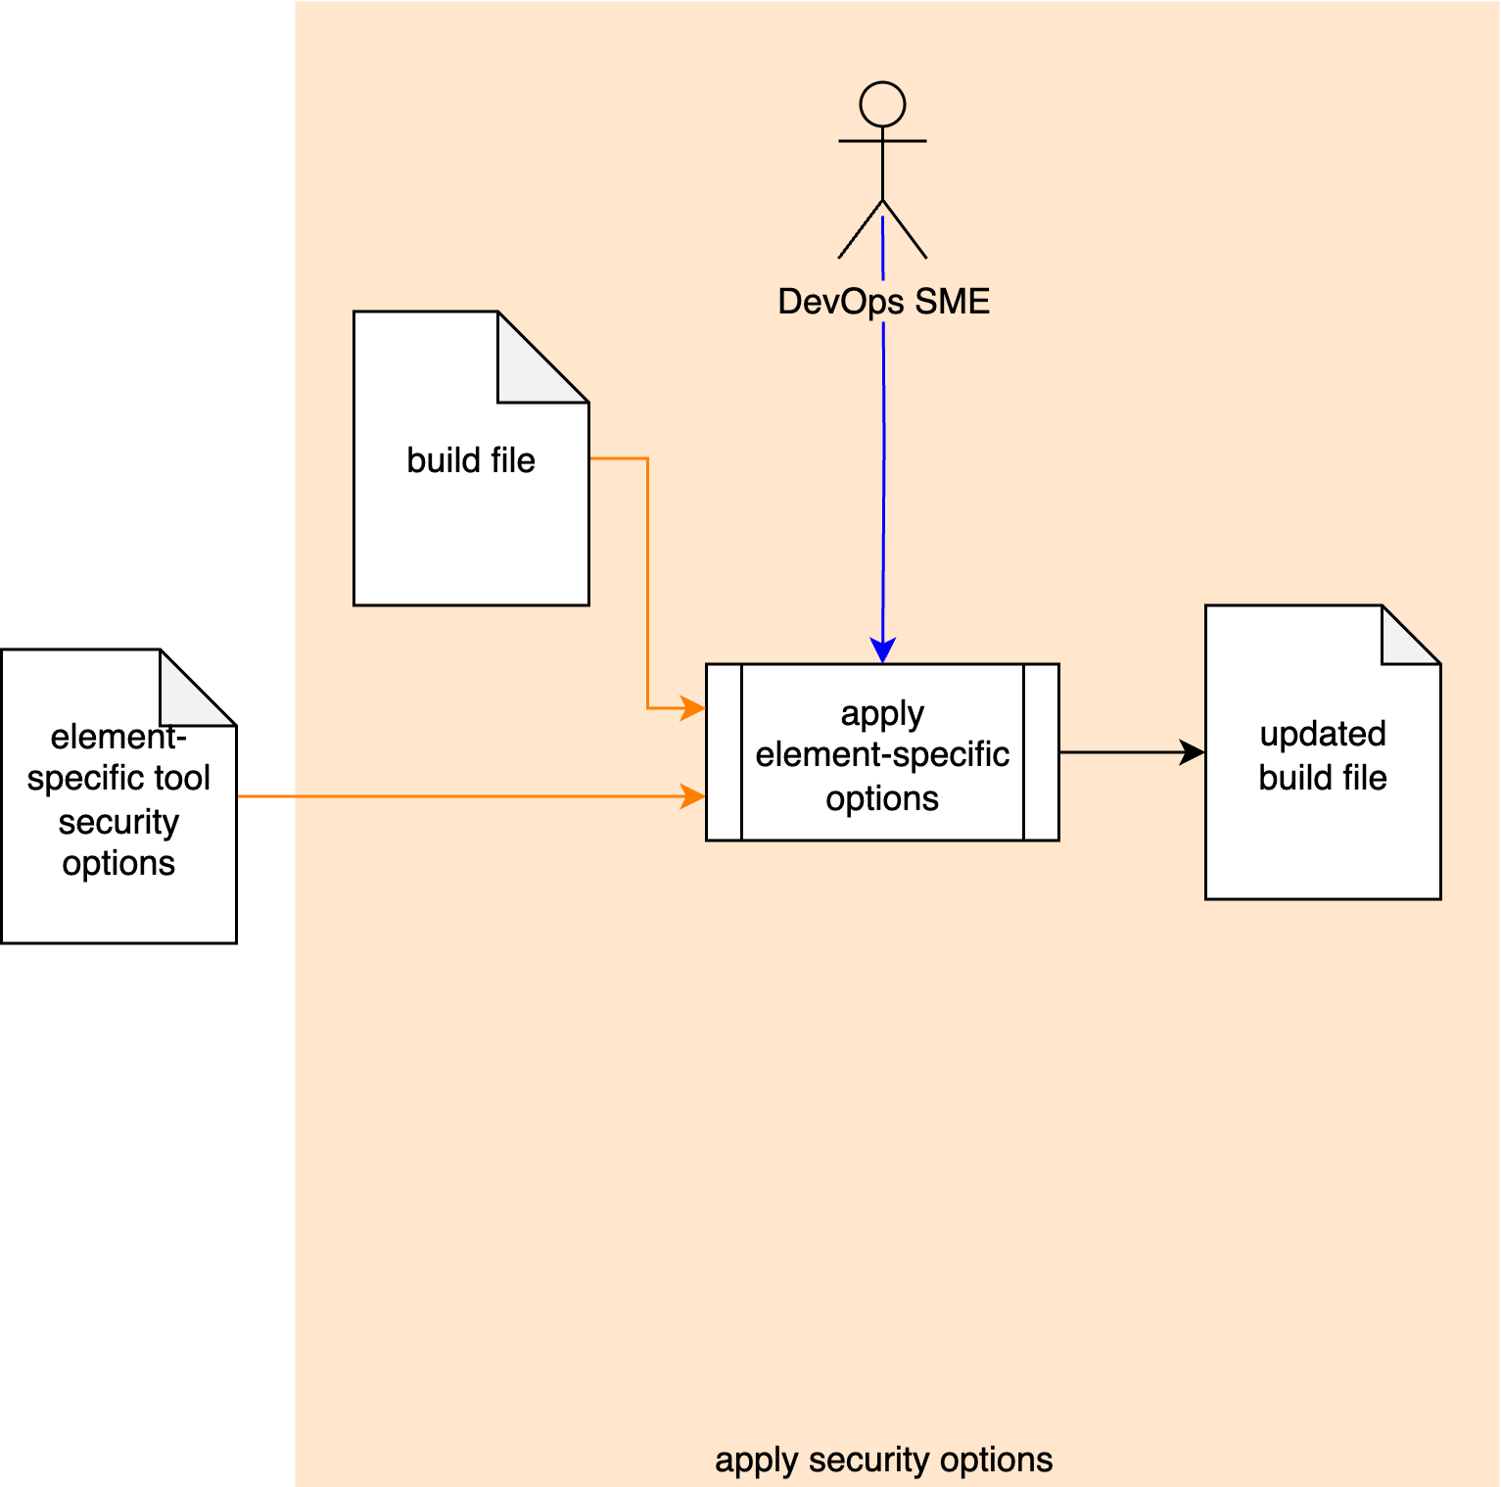
Secure Settings Process
Notes:
Script:
The secure settings process is comprised of four activities.
These are:
[break]
identifying the options relevant to security
[break]
categorizing those options
[break]
selecting which ones we're going to use for each element
[break]
and finally, applying those options to the build system for that element.

Slide 12
Secure Settings Material
Notes:
Script:
Now, let's briefly review the materials that provide both documentation and training for how the secure settings activities should be undertaken.

Slide 13
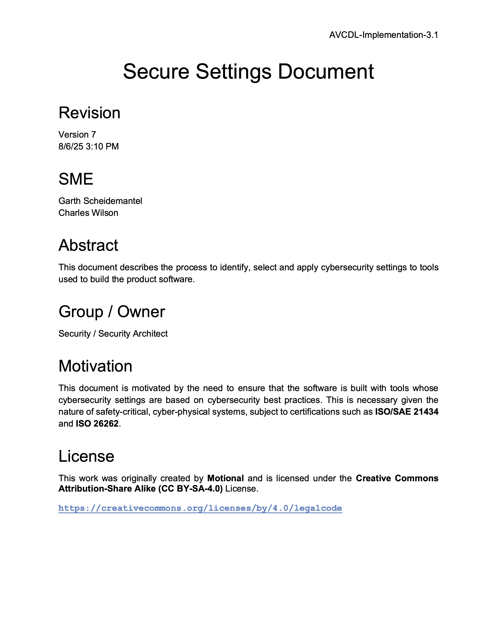
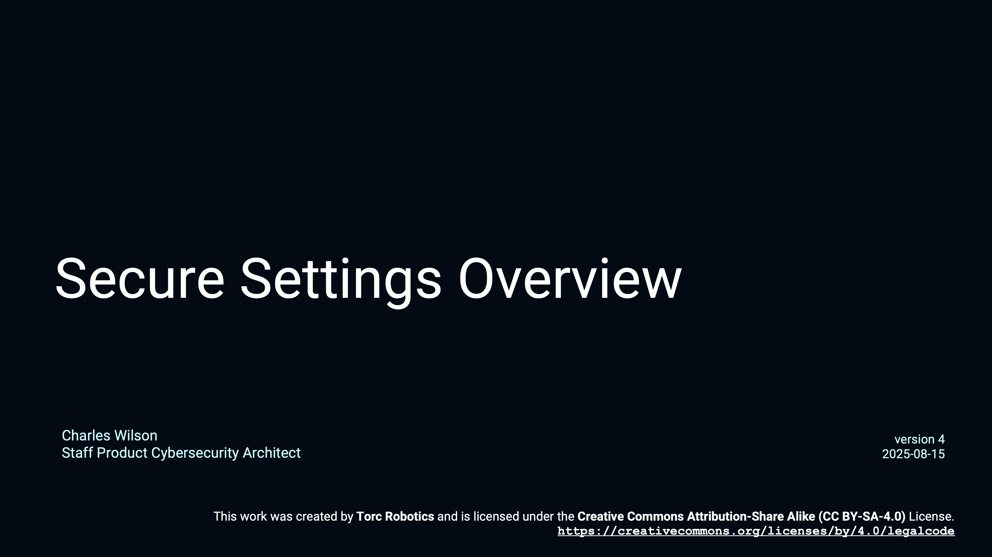
Secure Settings - Overview
Notes:
Script:
First, we have the Secure Settings Overview training video which compliments
the Secure Settings Document secondary document
and provides an overview of the secure settings process described in the AVCDL primary document.

Slide 14
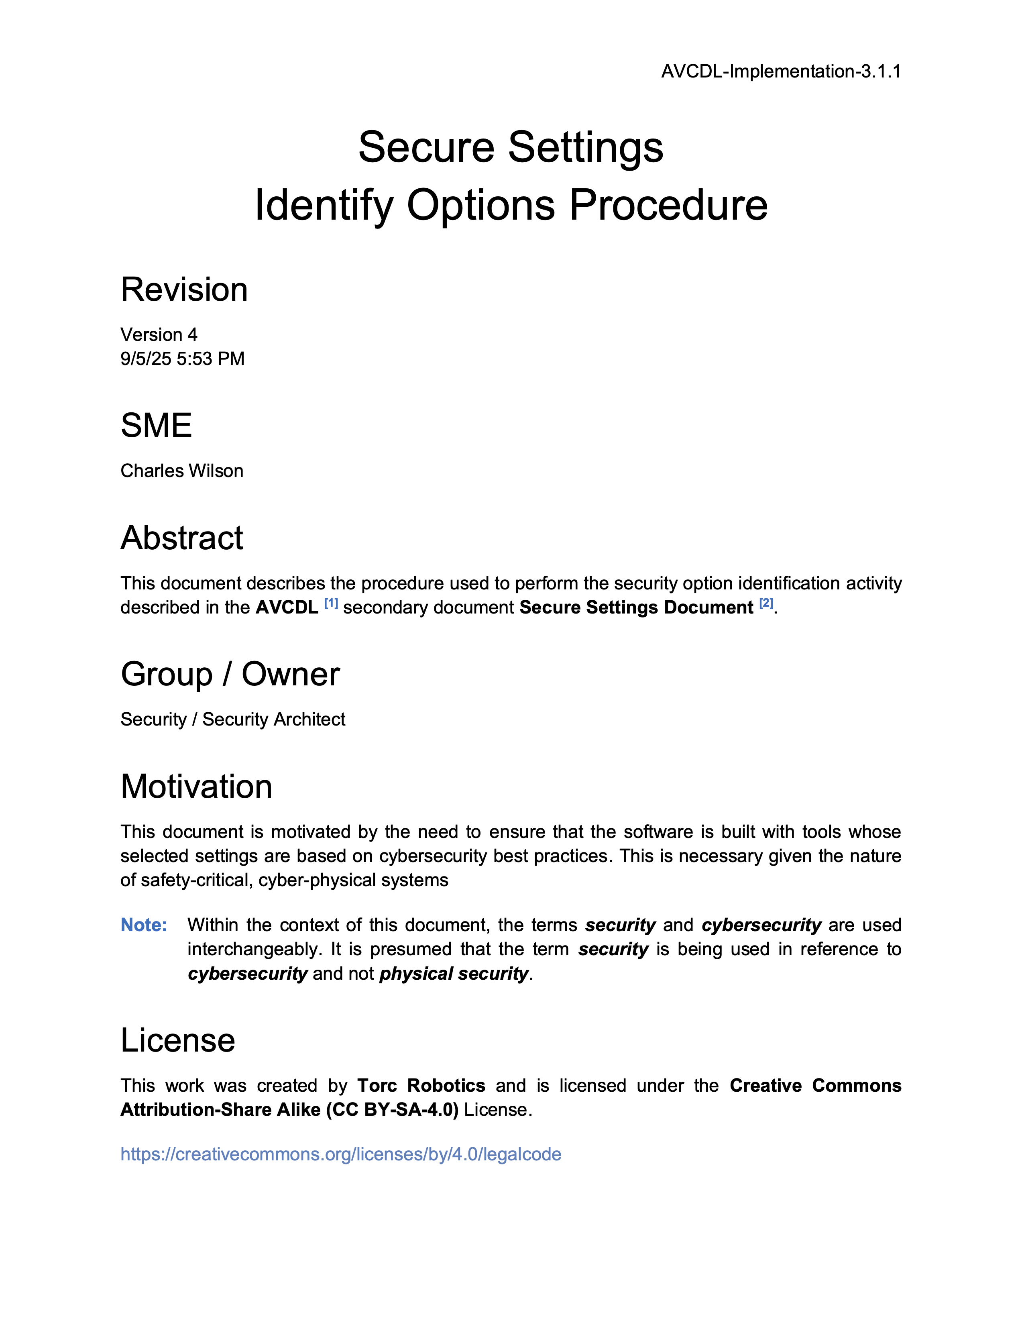
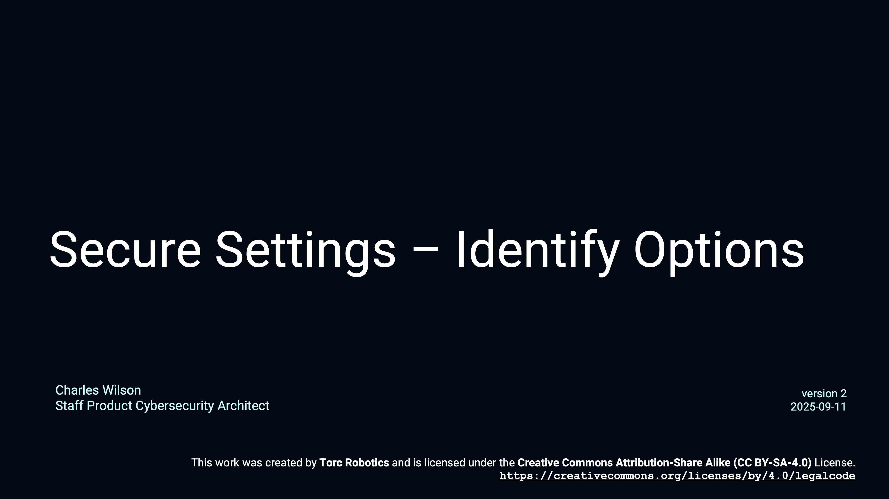
Secure Settings – Identify Options
Notes:
Script:
The Secure Settings - Identify Options training goes along with the Secure Settings Identify Options Procedure.
It works its way through an example using GCC as a basis covering how one would take a tool and extract the various options from it.

Slide 15
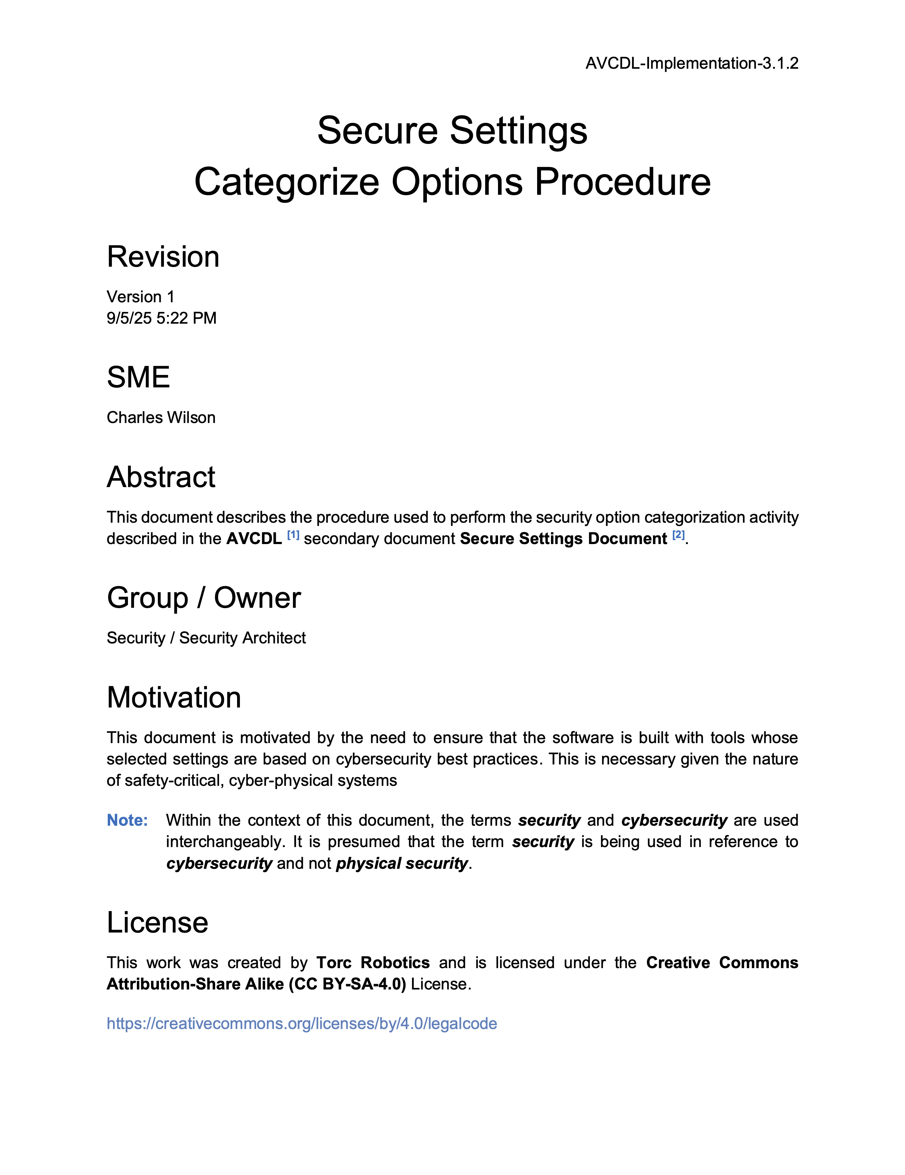
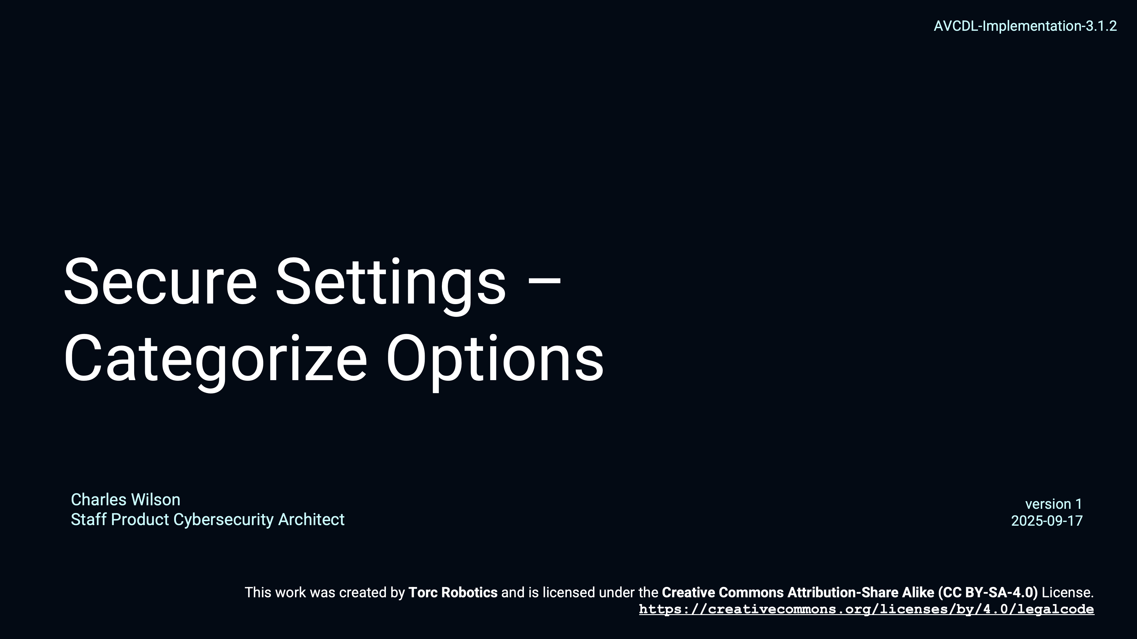
Secure Settings – Categorize Options
Notes:
Script:
The Secure Settings - Categorize Options training goes along with the Secure Settings Categorize Options Procedure.
It extends the example from the identify options training and covers how one might create severity categories and categorize the identified options so that they can be processed later.

Slide 16
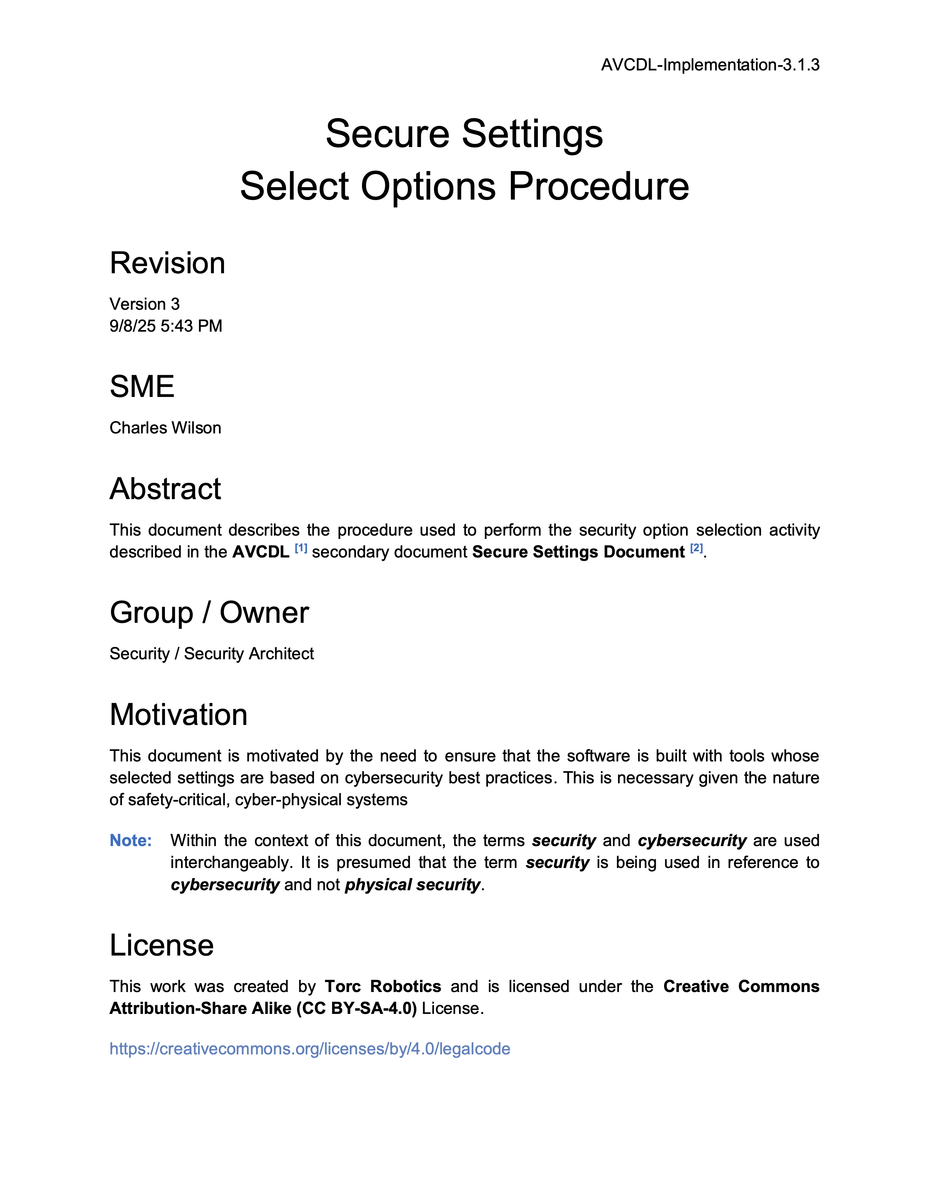
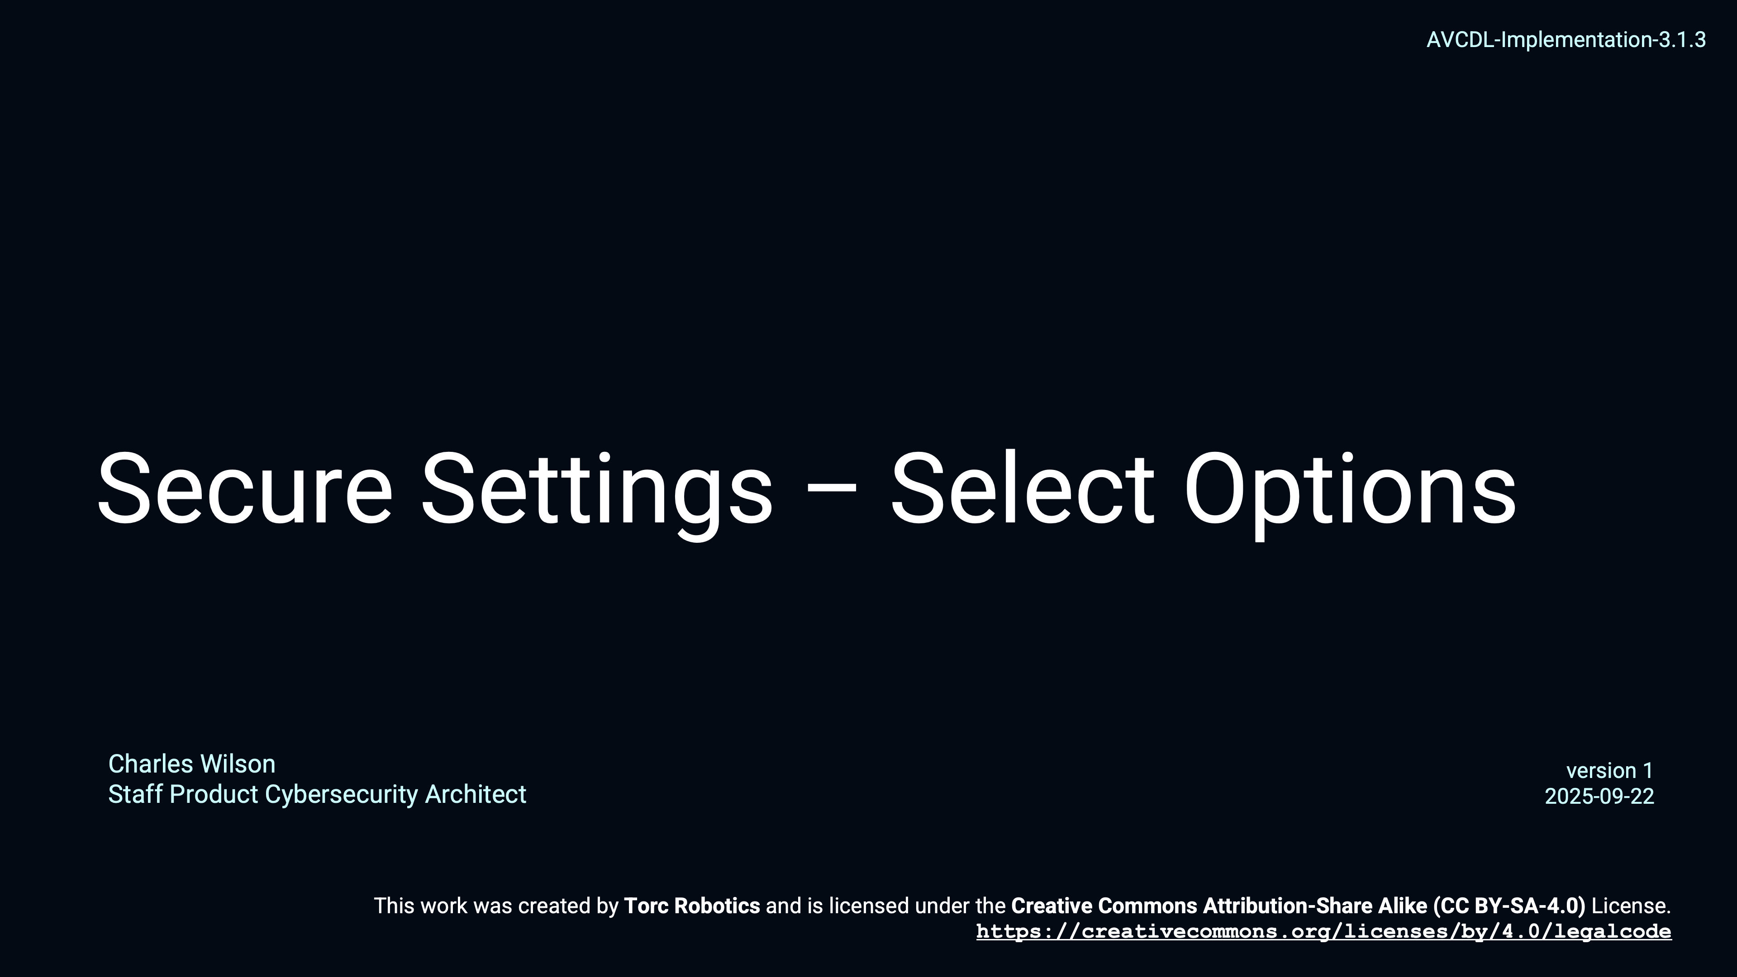
Secure Settings – Select Options
Notes:
Script:
The Secure Settings - Select Options training goes along with the Secure Settings Select Options Procedure.
It continues extending the example from the previous training and addresses how options are selected for application to a specific element of the system by the cybersecurity and development SMEs.

Slide 17

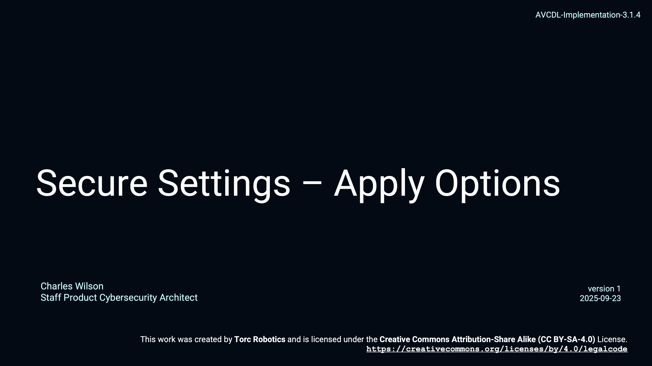
Secure Settings – Apply Options
Notes:
Script:
Finally, the Secure Settings - Apply Options training goes along with the Secure Settings Apply Options Procedure.
The focus here is on the devops SME, tasked with taking the options selected for application to a particular element, and making the adjustments to the build system to integrate those options.

Slide 18
Dynamic Analysis Considerations
Notes:
Script:
Since the Secure Settings process activities speak in general, let's talk about the specific things we need to consider when establishing the dynamic analysis settings.

Slide 19
Considerations
Execution Time
Footprint
Notes:
Script:
Outside of the typical, this is cybersecurity-relevant question when dealing with particular tools and settings, there are two considerations that we make when we're establishing the settings to be attached to a particular system element subject to dynamic analysis.
This is because dynamic analysis is part of a test suite which is executed.
And so, we need to consider the execution time impact.
And that's because the build process may be time-bounded.
Since dynamic analysis, by its very nature, puts stress on the code, its execution may well exceed any time-bounding that's been established for the build process.
This needs to be evaluated before we recommend an option or tool for use with a particular element.
[pause]
The second is very much akin to the first, and that is a consideration of the footprint.
This may be the overall code size impact which is of concern when dealing with embedded systems.
You have hard limits here, unlike when working on a desktop or server class machine.
[pause]
Beyond the footprint of the code, you have the data memory footprint.
Are you able to fit all of the necessary data into memory to be able to execute it efficiently and effectively?
Keep in mind that in real-time systems, if you're dealing with operating systems that have virtual paging systems in them, you have to take into consideration that the memory footprint is going to have an adverse effect on the execution time if you're thrashing memory because of it.

Slide 20
Recap
Notes:
Script:
That covers dynamic analysis settings establishment.
Let's look at a summary.

Slide 21
Summary
Select the options
Scope to the element
Update the build
Report the settings
Keep cybersecurity relevancy in mind
Notes:
Script:
When implementing the settings establishment for dynamic analysis tools, we follow the simple steps of:
[pause]
selecting the tool’s options
[pause]
scoping the options to the element
[pause]
updating the build
[pause]
and, of course, reporting our settings.
[pause]
Keep in mind when you're going through this exercise, that you're doing so from the cybersecurity perspective, and not the general dynamic analysis perspective, because although this is part of the test suite, not every test is cybersecurity-relevant.

Slide 22
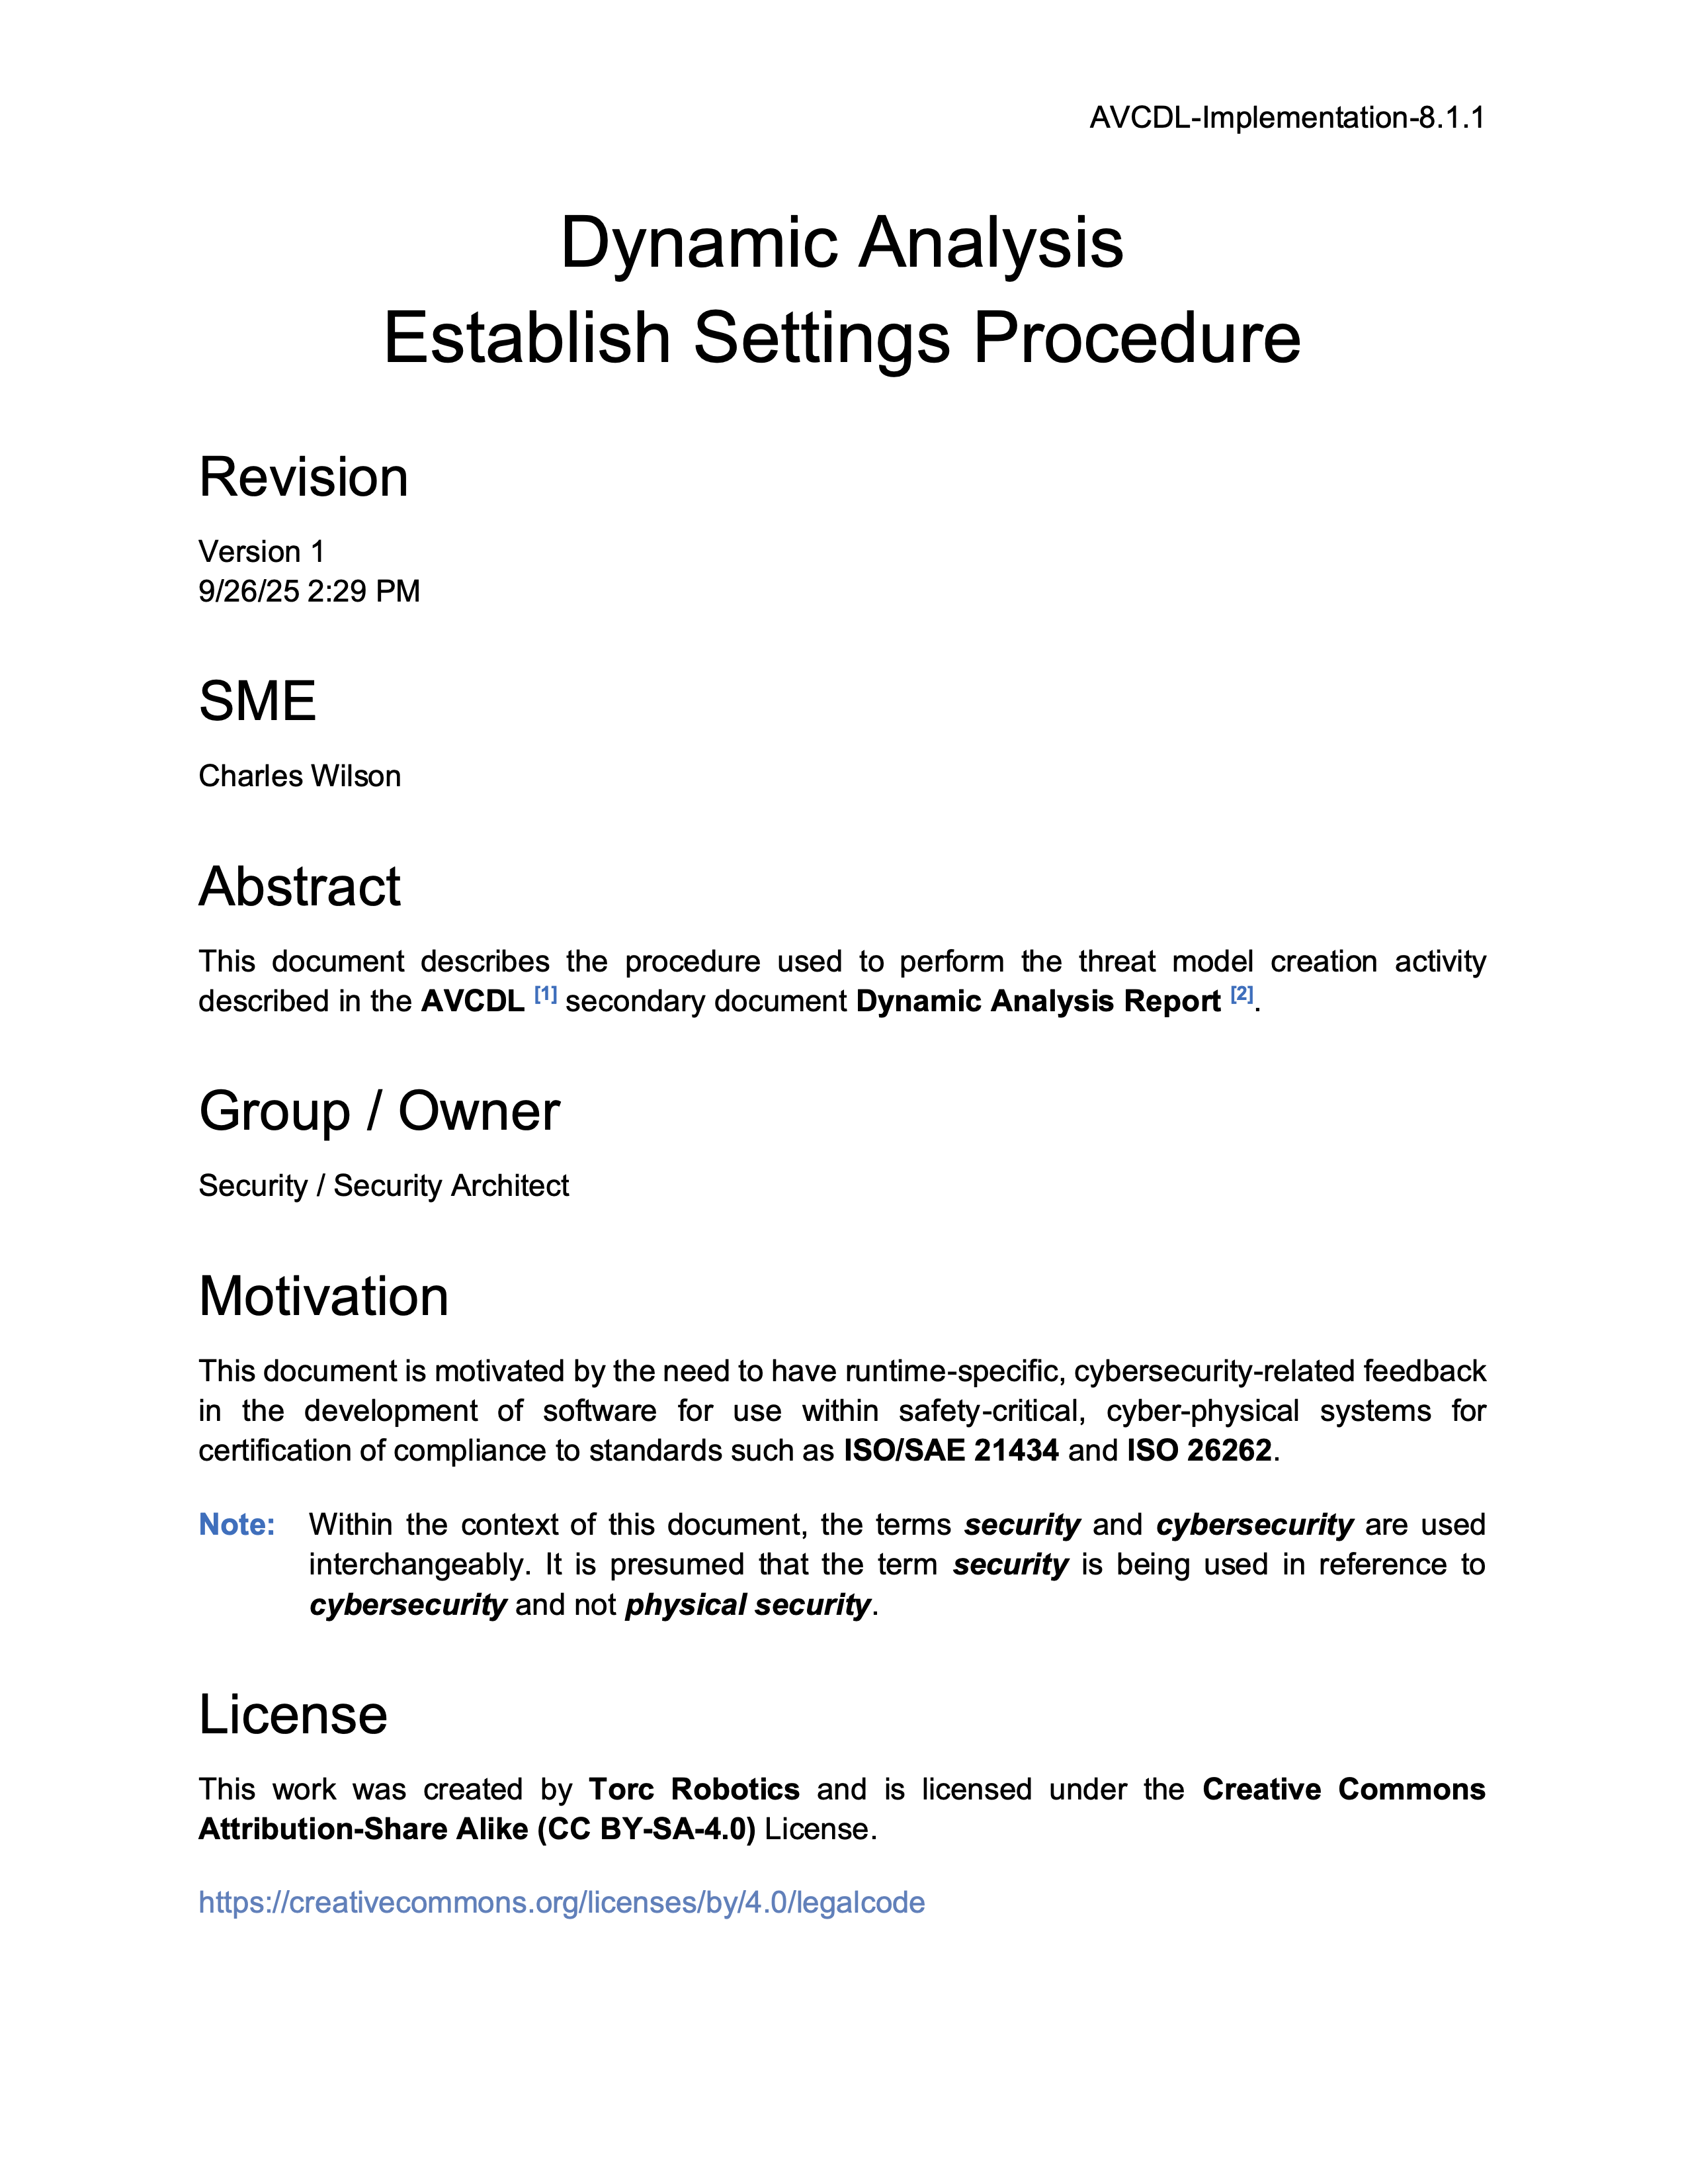
Further Reading
Notes:
Script:
For additional information and to get a more in-depth set of references, the Dynamic Analysis Establish Settings Procedure tertiary document is available in the AVCDL GitHub repository.

Slide 23
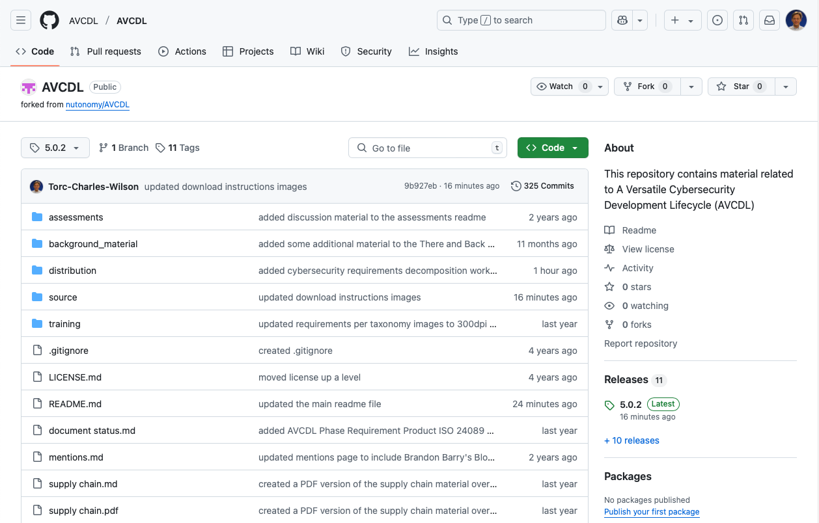
AVCDL on GitHub
https://github.com/AVCDL/AVCDL
Notes:
Script:
All AVCDL materials, both in source and distribution forms, are available on our GitHub site, as shown here.
Because of the size of the repository, it's recommended that you either clone the repository or download a ZIP archive of it, if you're not familiar with using git.
Instructions for downloading a ZIP archive are linked to on the repository’s front page.

Slide 24
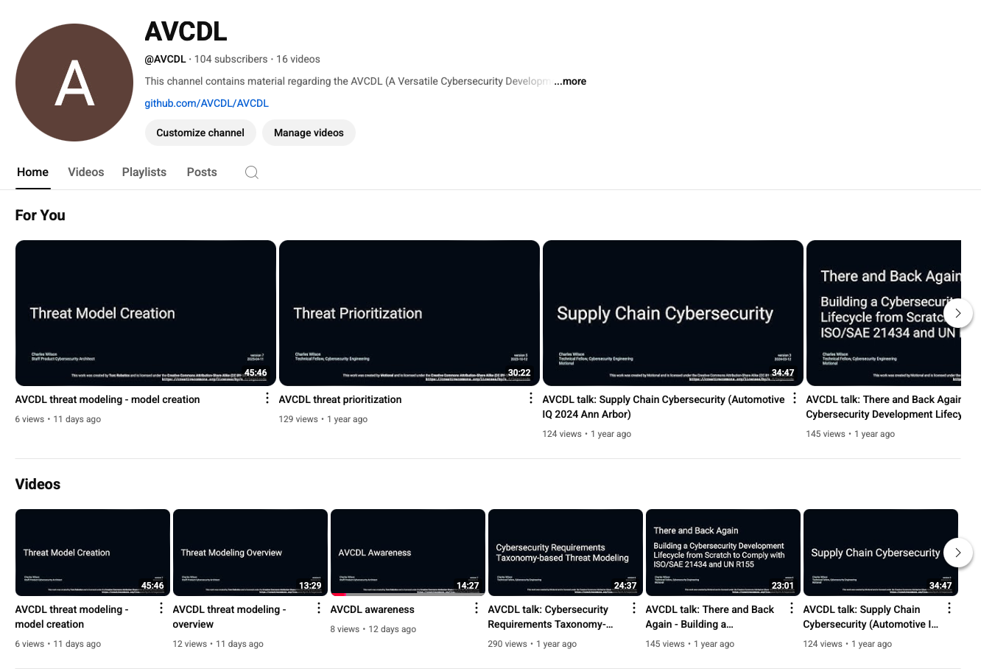
AVCDL on YouTube
https://youtube.com/@AVCDL
Notes:
Script:
Videos covering various aspects of the AVCDL are available on our YouTube channel, as shown here.
It's important to note that all AVCDL materials with the exception of the introductory blog posts are intended for product cybersecurity engineering practitioners.

Slide 25
Next Steps
Notes:
Script:
With this training complete, if you’ve completed the other trainings covering the Dynamic Analysis process activities, you can proceed to the other training at this level, these include:
Static Analysis
Fuzz Testing
and
Secure Code Review

Slide 26
References (1 of 2)
AVCDL primary document
Dynamic Analysis Report (AVCDL secondary document)
Dynamic Analysis – Establish Settings Procedure (AVCDL tertiary document)
Secure Settings Document (AVCDL secondary document)
Secure Settings – Identify Options Procedure (AVCDL tertiary document)
Secure Settings – Categorize Options Procedure (AVCDL tertiary document)
Secure Settings – Select Options Procedure (AVCDL tertiary document)
Secure Settings – Apply Options Procedure (AVCDL tertiary document)
AVCDL tool cybersecurity options template (AVCDL template)
AVCDL element-specific tool cybersecurity options template (AVCDL template)
Notes:
Script:
Here are the references to the source material used in the creation of this presentation.
They'll also be included in the video description.
Additionally, this presentation’s source material will be provided on the AVCDL GitHub repository.

Slide 27
References (2 of 2)
Address Sanitizer [LLVM]
https://clang.llvm.org/docs/AddressSanitizer.html
Thread Sanitizer [LLVM]
https://clang.llvm.org/docs/ThreadSanitizer.html
Memory Sanitizer [LLVM]
https://clang.llvm.org/docs/MemorySanitizer.html
Leak Sanitizer [LLVM]
https://clang.llvm.org/docs/LeakSanitizer.html
Undefined Behavior Sanitizer [LLVM]
https://clang.llvm.org/docs/UndefinedBehaviorSanitizer.html
Notes:
Script:
Here are the references to the source material used in the creation of this presentation.
They'll also be included in the video description.
Additionally, this presentation’s source material will be provided on the AVCDL GitHub repository.

